Slide 1
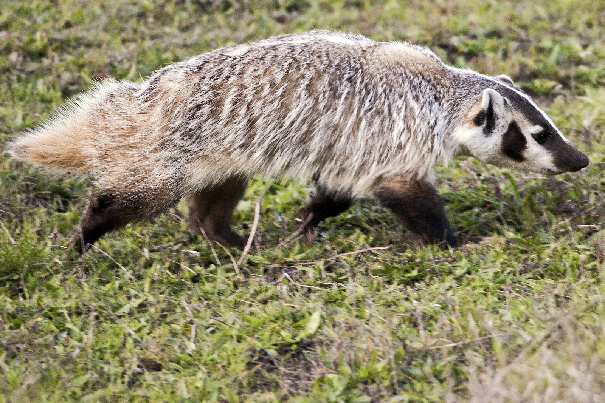
Badger Bank
Contact us
Phone: 555-555-4321
Email:badgerbank@example.com
Logout
Tip of the Day
Welcome!
Don't badger the environment, enroll in paperless statements today!
Name: Bucky Badger
Email: bucky.badger@example.com
Phone Number: 555.555.1234
Your Enrolling State: False
Enroll/Unenroll
Your Checkings and Savings Acounts
Download Account Statements
Download Tax Statements
Checking Account xxx126
Savings Account xxx271
Savings Account xxx918
Balance: 472.61 Interest Rate: 0.00%
Balance: 248.34 Interest Rate: 0.06%
Balance: 5027.03 Interest Rate: 0.06%
Date | Description | Amount | Balance
09/13/2020 | CHECK 192 | -30.82 | 472.61
09/02/2020 | MNTHLY DPST UW PAYROLL | 321.87
08/27/2020 | CHECK 191 | -750.00
08/14/2020 | CHECK 188 | -10.00
08/02/2020 | MNTHLY DPST UW PAYROLL | 637.91
07/18/2020 | VENMO | -25.00
Date | Description | Amount | Balance
07/21/2020 | TRANSFER FROM EXT. ACCT | 67.23 | 248.34
07/01/2020 | TRANSFER FROM EXT. ACCT | 52.68
04/06/2020 | TRANSFER TO EXT. ACCT. | -127.63
03/11/2020 | TRANSFER FROM EXT. ACCT | 100.00
02/14/2020 | TRANSFER TO EXT. ACCT. | 50.00
01/01/2020 | INTEREST PAID | 0.06
Name | Description | Amount | Balance
01/01/2020 | INTEREST PAID | 3.01 | 5027.03
09/01/2020 | TRANSFER TO EXT. ACCT. | -5000.00
01/01/2019 | INTEREST PAID | 6.01
01/01/2018 | INTEREST PAID | 6.01
01/01/2016 | INTEREST PAID | 6.00
01/01/2015 | INTEREST PAID | 6.00
Your Checkings and Savings Acounts
Name | Email
Goldy Golpher | goldy.gopher@example.com
Pioneer Pete | pioneer.pete@example.com
Add Beneficiary

Slide 2
Badger Bank
Contact us
Phone: 555-555-4321
Email:badgerbank@example.com
Logout
Tip of the Day
Welcome!
Don't badger the environment, enroll in paperless statements today!
Check your account information
Name: Bucky Badger
Email: bucky.badger@example.com
Phone Number: 555.555.1234
Your Enrolling State: False
Enroll/Unenroll
Your Checkings and Savings Acounts
Download Account Statements
Download Tax Statements
Checking Account xxx126
Savings Account xxx271
Savings Account xxx918
Balance: 472.61 Interest Rate: 0.00%
Balance: 248.34 Interest Rate: 0.06%
Balance: 5027.03 Interest Rate: 0.06%
Date | Description | Amount | Balance
09/13/2020 | CHECK 192 | -30.82 | 472.61
09/02/2020 | MNTHLY DPST UW PAYROLL | 321.87
08/27/2020 | CHECK 191 | -750.00
08/14/2020 | CHECK 188 | -10.00
08/02/2020 | MNTHLY DPST UW PAYROLL | 637.91
07/18/2020 | VENMO | -25.00
Date | Description | Amount | Balance
07/21/2020 | TRANSFER FROM EXT. ACCT | 67.23 | 248.34
07/01/2020 | TRANSFER FROM EXT. ACCT | 52.68
04/06/2020 | TRANSFER TO EXT. ACCT. | -127.63
03/11/2020 | TRANSFER FROM EXT. ACCT | 100.00
02/14/2020 | TRANSFER TO EXT. ACCT. | 50.00
01/01/2020 | INTEREST PAID | 0.06
Name | Description | Amount | Balance
01/01/2020 | INTEREST PAID | 3.01 | 5027.03
09/01/2020 | TRANSFER TO EXT. ACCT. | -5000.00
01/01/2019 | INTEREST PAID | 6.01
01/01/2018 | INTEREST PAID | 6.01
01/01/2016 | INTEREST PAID | 6.00
01/01/2015 | INTEREST PAID | 6.00
Your Checkings and Savings Acounts
Name | Email
Goldy Golpher | goldy.gopher@example.com
Pioneer Pete | pioneer.pete@example.com
Add Beneficiary

